Slide 1

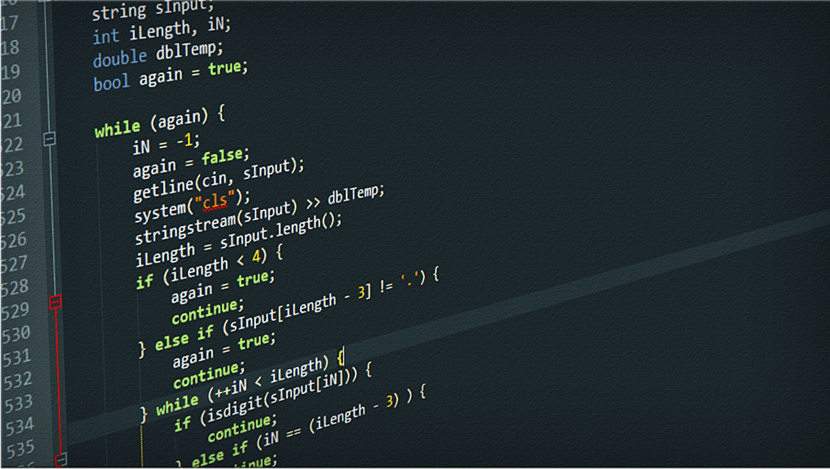
OOP Project

Slide 2
ACKNOWLEGEMENT
We would like to express our special thanks of gratitude to our CSE branch HOD Dr. SAROJA DEVI and our subject faculty Mr. Vinay T.R. for giving us the opportunity to work on this project and enhance our skills in various sections of the subject as well as our presentation skills.
Working on this project has been immensely useful in the aspect of learning. It helped us to explore various resources and enhance of potentials to work in team and bring up a considerable output of our efforts.

Slide 3
Programming Hierarchy
Machine language
Assembly level language
Structured programming
Object oriented programming

Slide 4
OBJECT ORIENTED PROGRAMMING
Object is the basic unit of oops which aims at dividing the program into several operational units.
FEATURES
ADVANTAGES
PROGRAMMING HIERARCHY
Class
Abstraction
Encapsulation
Inheritance
Polymorphism
Re-usability
Data Redundancy
Code Maintenance
Security
Better productivity
Easy troubleshooting
Machine Language
Assembly Language
Structured Programming
Object Oriented Programming

Slide 5

Created by-
Guided by-
Snehil Kumar
Shushank Chaudhary
Samridhi Srivastava
Pranto Biswas
Mr. Vinay T.R.

Slide 6
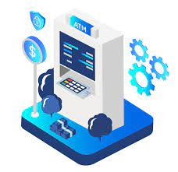

ATM DATA MANAGEMENT

Slide 7
ABOUT THE PROJECT
ATMs are Automated Teller Machines that are used to carry day-to-day financial transactions. ATMs can be used to withdraw money or to deposit money or even to know the information of an account like the balance amount, etc. They are convenient and easy to use, it allows consumers to perform quick self-service transactions . In this article, we will discuss the ATM Management System in C++ which is an application that provides users with every aspect that an actual Automated Teller Machine do.

Slide 8
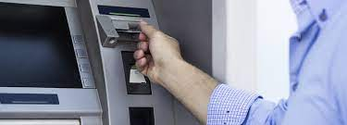
The project to be designed will control a simulated automated teller machine (ATM) having a magnetic stripe reader for reading an ATM card, a customer console (keyboard and display) for interaction with the customer, a slot for depositing envelopes, a dispenser for cash (in multiples of $20), a printer for printing customer receipts, and a key-operated switch to allow an operator to start or stop the machine. The ATM will communicate with the bank's computer over an appropriate communication link. Design the ATM system in detail with the architectural design. Use cases, sequence diagrams, class structural models and behavioral models.
ABOUT THE DATA MANAGEMENT

Slide 9
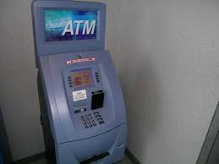
ABOUT THE ATM WORKING
Enter Name, Account number, Account type to be shown during transactions . Shows the information about the person who is doing the transaction . Enter amount to deposited in the account . Shows the Balance in the account. Enter amount to be withdrawn from the account, and then it shows available balance .Cancel the transaction
As this is software it can be used by a wide variety of banks to automate the process of manually maintaining the records related to the each transaction of bank account holder. This system will cover the following modules:-
1.Cash Withdrawal
2.Balance Enquiry
3.Cash Deposit.

Slide 10
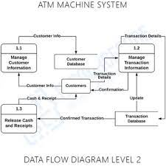
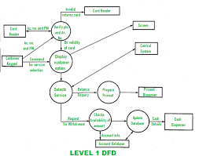
DESIGN

Slide 11
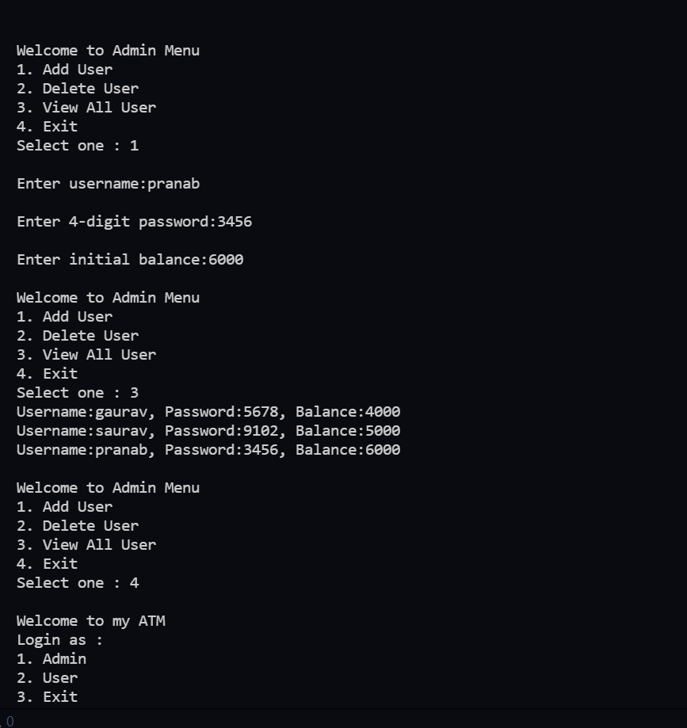
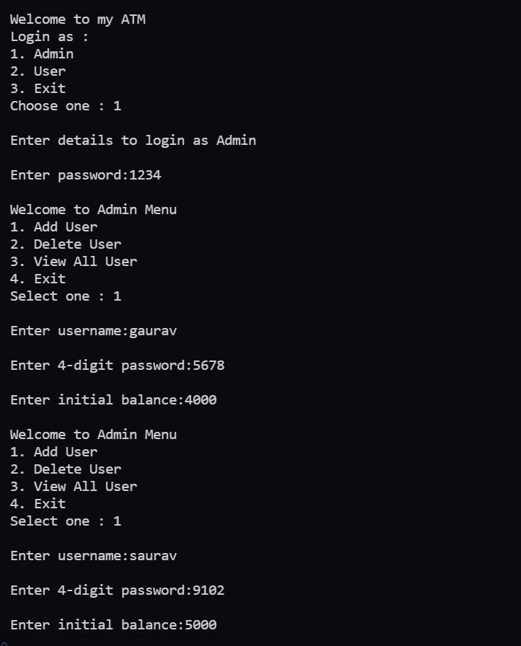
IMPLEMENTATION

Slide 12
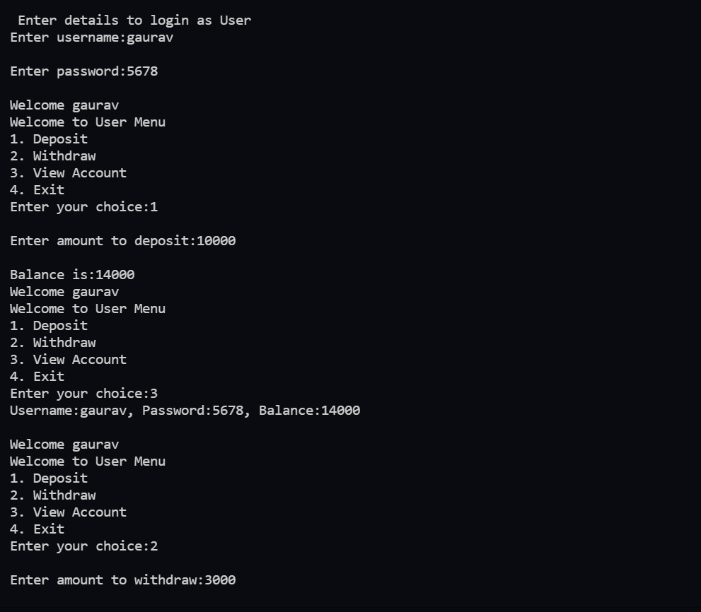
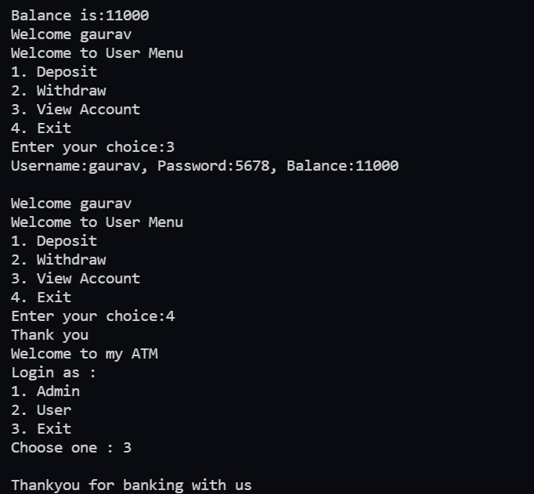

Slide 13
A• “C++ Primer” ,Stanley B Lippman, 4th edition, Addison Wesley, 2005 • “Object Oriented Programming With C++” , Sourav Sahey, Oxford University, 2006 ➢ Referred Links: • www.wikipedia.com • www.stackoverflow.com • www.geeksforgeeks.com • www.edureka.com
REFERENCES

Slide 14
THANK YOU

